Slide 1
Software Project Management
Sarah Mazhar

Slide 2
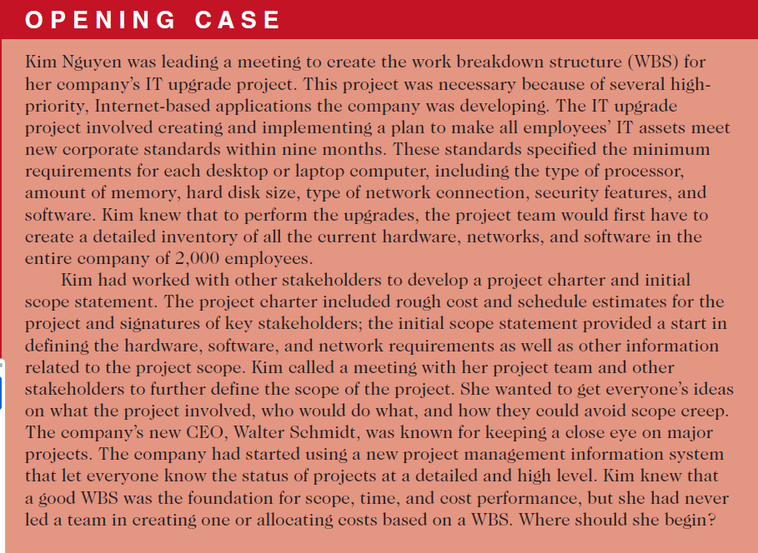

Slide 3
Project Scope Management
A critically important and difficult aspect of project management is defining the scope of a project.
Scope refers to all the work involved in creating the products of the
project and the processes used to create them.
A deliverable is a product created as part of a project.
Deliverables can be product-related, such as a piece of hardware or software, or process-related, such as a planning document or meeting minutes.
Project stakeholders must agree on what the products of the project are and, to some extent, how they should be produced to define all of the deliverables

Slide 4
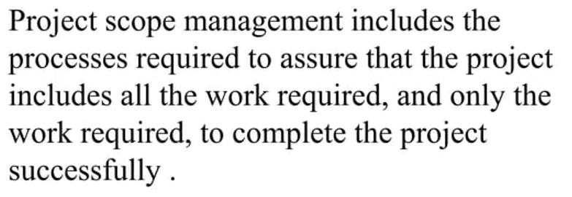
Project scope management includes the processes involved in defining and controlling what work is or is not included in a project.
It ensures that the project team and stakeholders have the same understanding of what products the project will produce and what processes the project team will use to produce them.

Slide 5
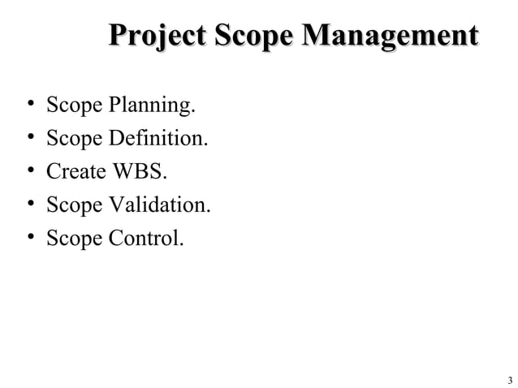

Slide 6
Six main processes are involved in project scope management according to the latest research:
1. Planning scope management involves determining how the project’s scope and requirements will be managed.
2. Collecting requirements involves defining and documenting the features and functions of the products as well as the processes used for creating them.

Slide 7
3. Defining scope involves reviewing the scope management plan, project charter, requirements documents, and organizational process assets to create a scope statement, adding more information as requirements are developed and change requests are approved.
4. Creating the WBS involves subdividing the major project deliverables into smaller, more manageable components.

Slide 8
5. Validating scope involves formalizing acceptance of the project deliverables.
Key project stakeholders, such as the customer and sponsor for the project, inspect and then formally accept the deliverables during this process. If the deliverables are not acceptable, the customer or sponsor usually requests changes.
6. Controlling scope involves controlling changes to project scope throughout the life of the project—a challenge on many IT projects. Scope changes often influence the team’s ability to meet project time and cost goals, so project managers must carefully weigh the costs and benefits of scope changes

Slide 9
The first step in project scope management is planning how the scope will be managed throughout the life of the project.
After reviewing the project management plan, project charter, enterprise environmental factors, and organizational process assets, the project team uses expert judgment, data analysis, and meetings to develop two important outputs: the scope management plan and the requirements management plan.

Slide 10
Scope management plan
The scope management plan is a subsidiary part of the project management plan which is made during Project Integration Management.
It can be informal and broad or formal and detailed, based on the needs of the project.
In fact, small projects may not need a written scope management plan, but large projects or highly technical projects often benefit from one.

Slide 11


project management plan,
project charter,
enterprise environmental factors
organizational process assets
Scope management plan
expert judgment, data analysis, and meetings
Requirements management plan

Slide 12
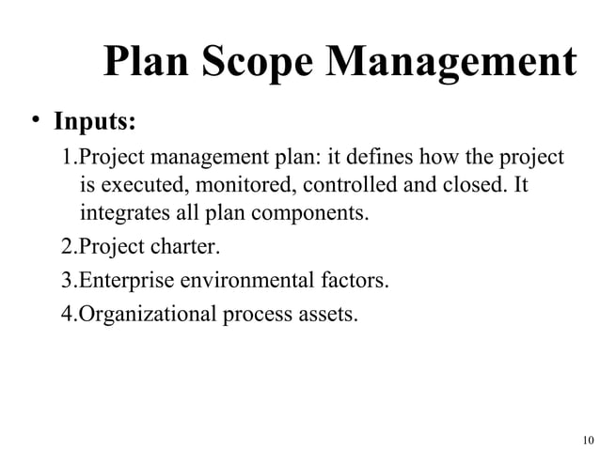

Slide 13
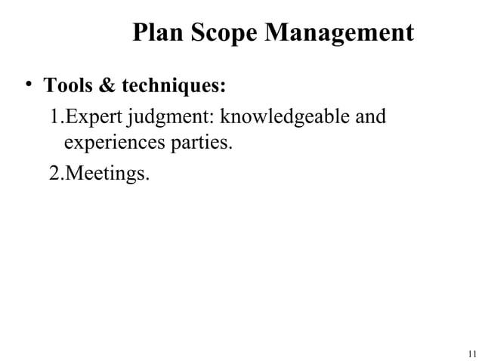

Slide 14
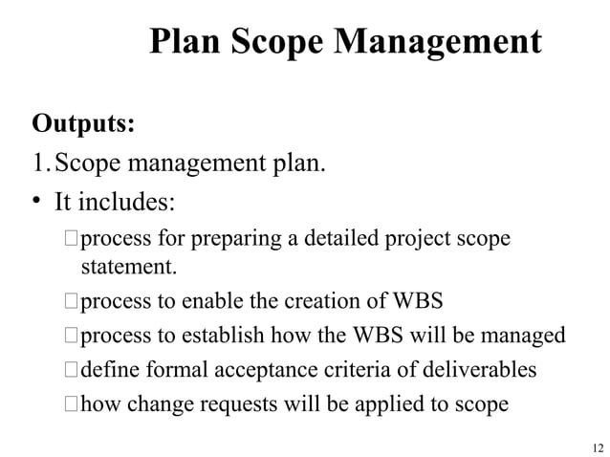

Slide 15
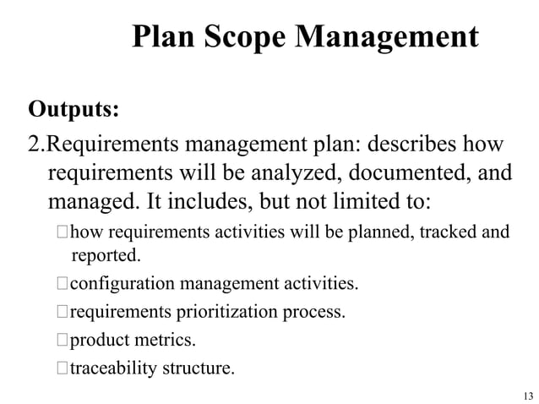

Slide 16
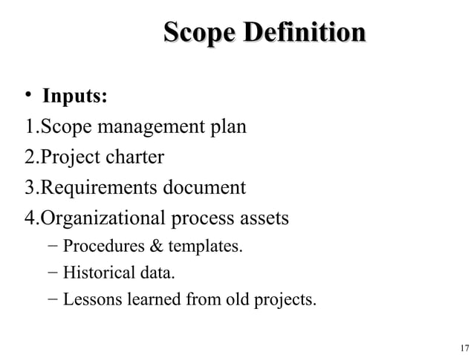

Slide 17
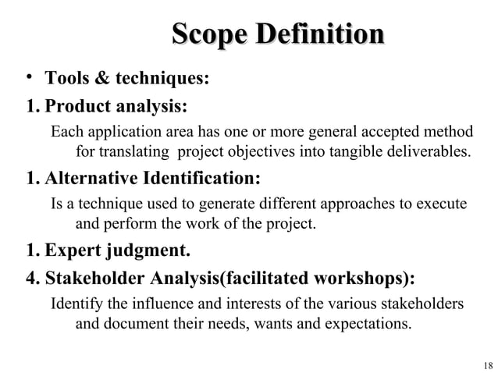
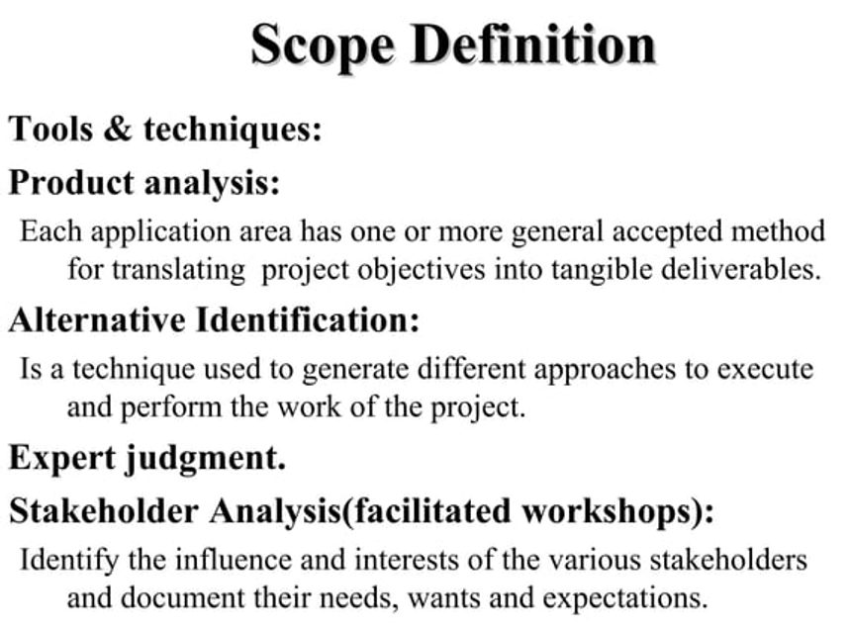

Slide 18
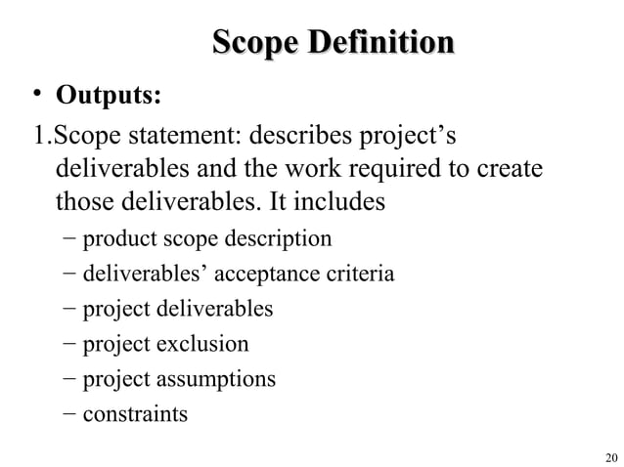

Slide 19
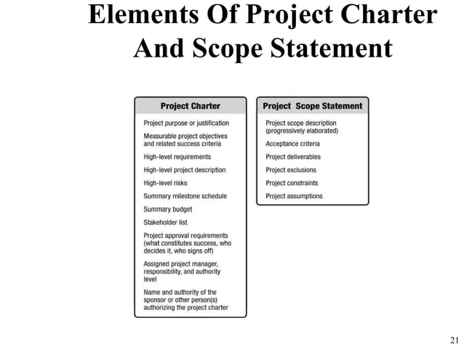

Slide 20
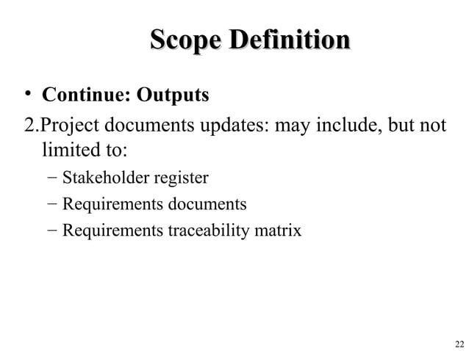

Slide 21
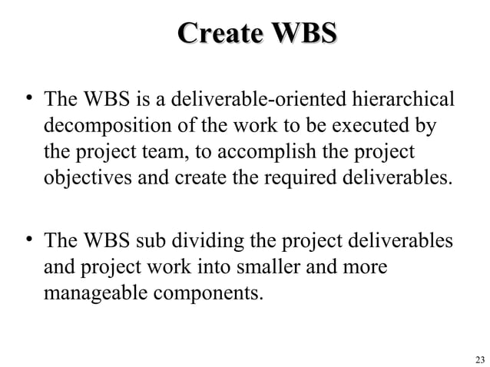

Slide 22
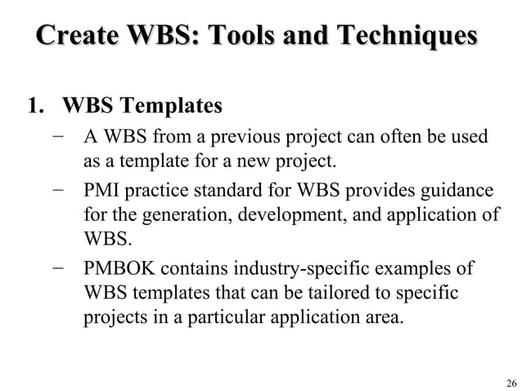

Slide 23
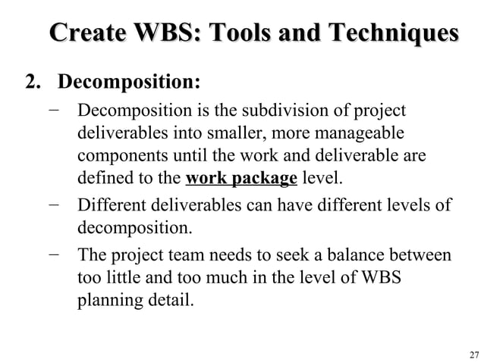

Slide 24
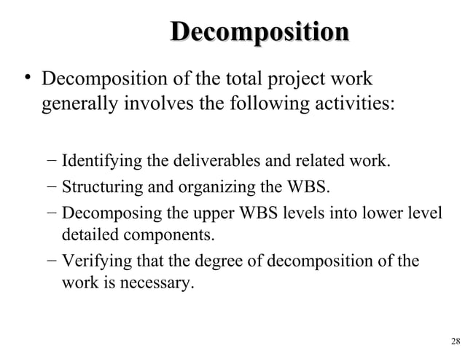

Slide 25
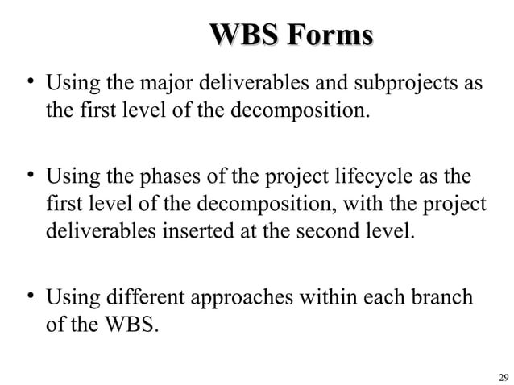

Slide 26
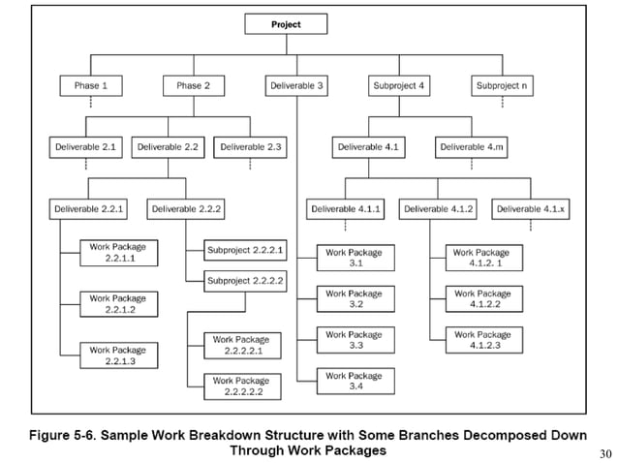

Slide 27
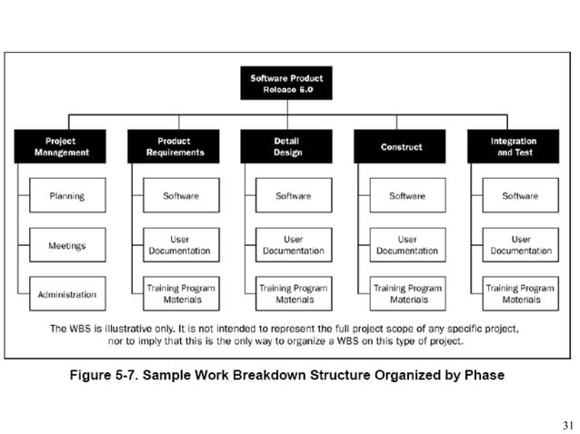

Slide 28
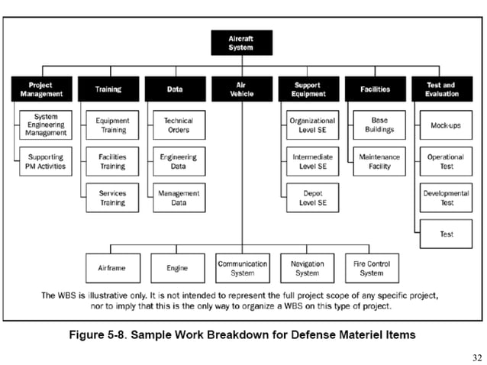

Slide 29
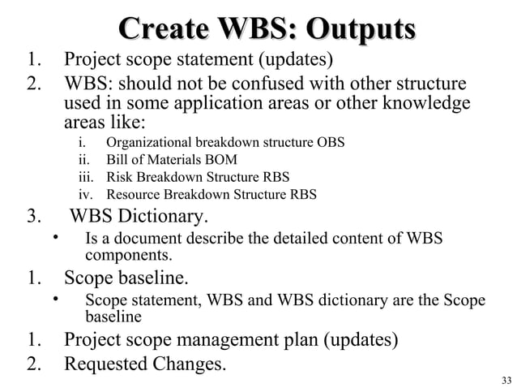

Slide 30
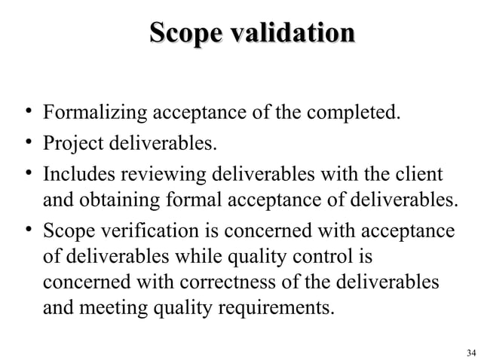

Slide 31
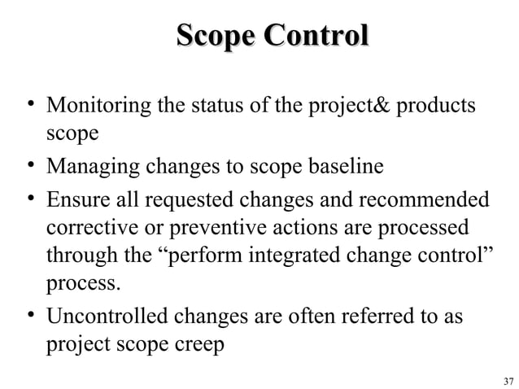

Slide 32
